Slide 1
NON-LINEAR WIRELESS PRESENTING
Ver 1.4
Colm Dunphy

Slide 2
INTRODUCTION
1. TIED (WIRED)
2. TETHERED (WIRELESS)
Apple
Android
Windows
Amazon FireStick
Android TV
3. RECORDING
iPad Pro
SWIVL
MOVI
4. MEDIA HOSTING
Video
Audio

Slide 3
TIED (WIRED)
SECTION 1

Slide 4


1. Presenting with a tablet/phone
USING OLD DATA PROJECTORS
Use a VGA adapter with your tablet / phone
Connect this as you would a laptop to older data projectors

Slide 5
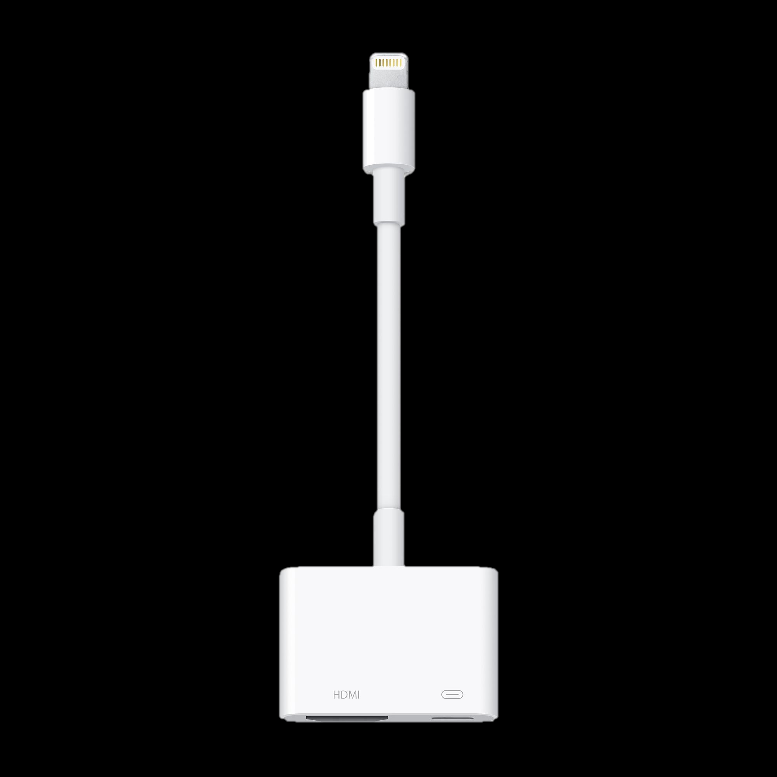
1. Presenting with a tablet/phone
USING NEW DATA PROJECTORS
Use a HDMI display adapter with your tablet / phone
Connect this as you would a laptop to newer data projectors

Slide 6
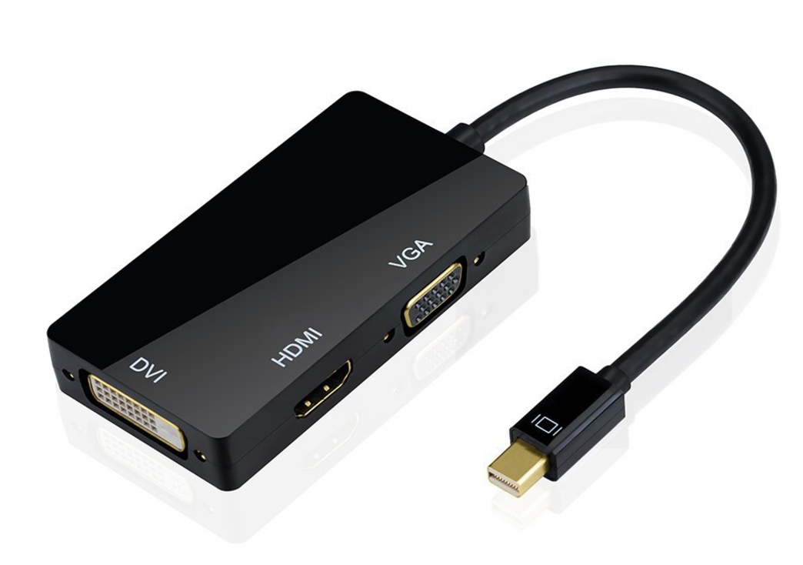
Multi Adapter
Single connector supports all 3:
VGA
DVI
HDMI

Slide 7
TETHERED (WIRELESS)
SECTION 2

Slide 8
WIRELESS Presenting - REQUIREMENTS
Tablet / phone
Screen mirroring device (Miracast is the generic term)
Both connected to the same WIFI network

Slide 9
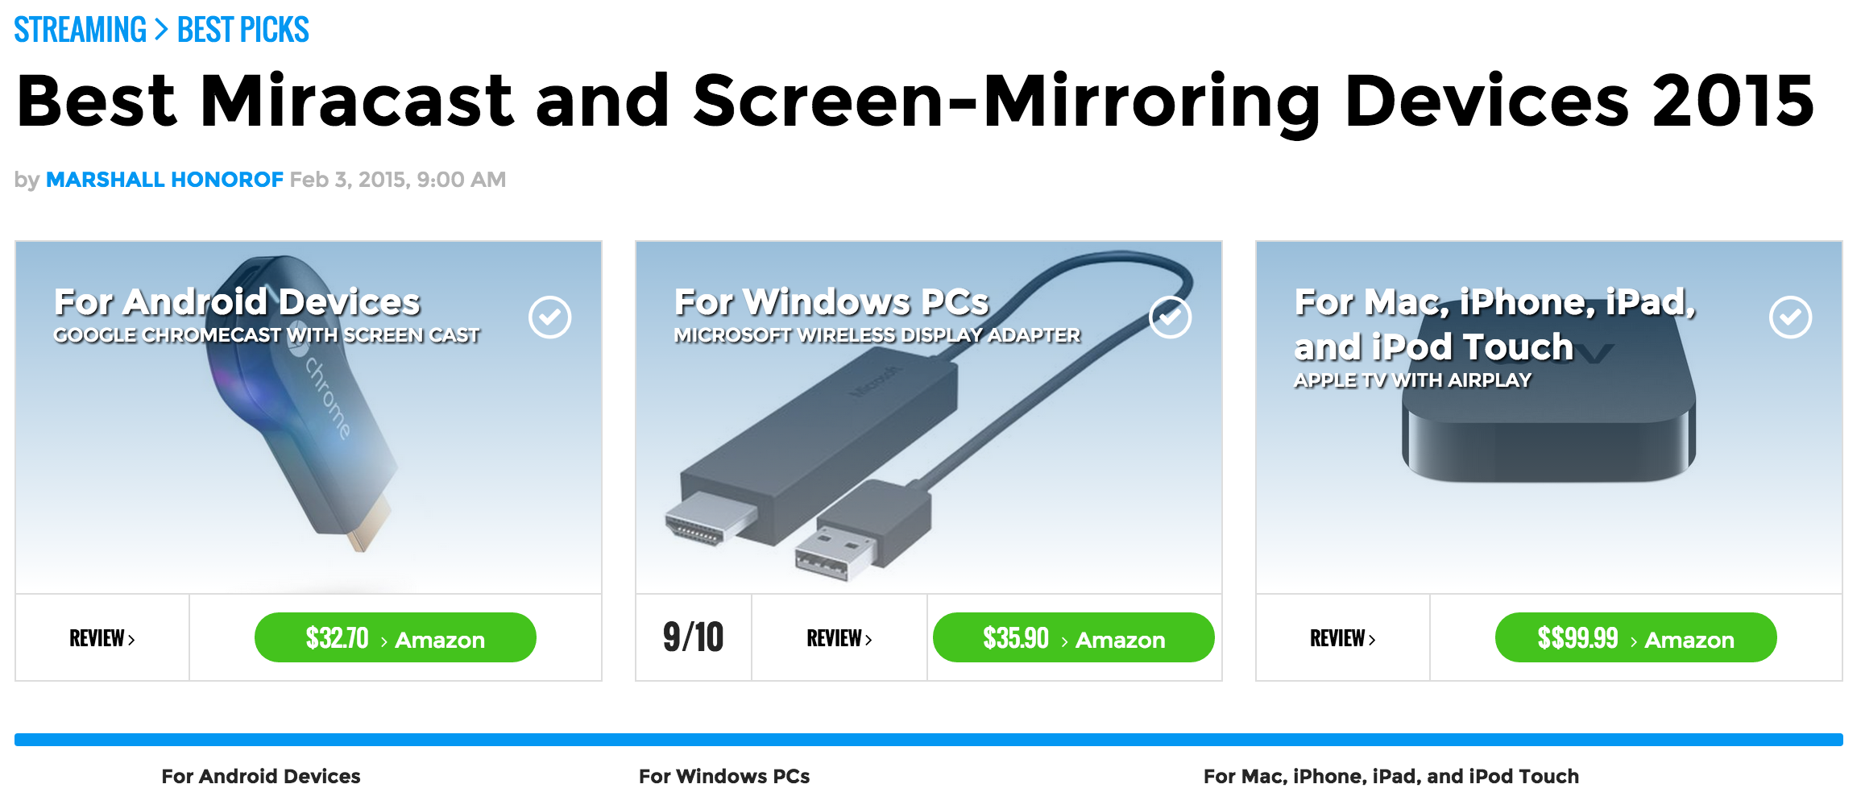
SCREEN MIRRORING DEVICES
SRC: http://www.tomsguide.com/us/best-miracast-screen-mirroring,review-2286.html

Slide 10
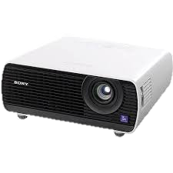


1. APPLE AIRPLAY

Slide 11
Explanation (1)
IPAD that needs to connect to a WIFI network
APPLE TV that needs to connect to the same WIFI network
Forget about using the college WIFI for this. Instead create your own using either
A WIFI router (e.g Apple Airport wired to college ethernet & AppleTV. You should check with Computer Services that the ethernet port will work. Then connect the iPad wirelessly to the router)
OR if you have an unlimited data plan on your phone, simply turn on a WIFI hotspot on your phone
This is susceptible to noise and network stability

Slide 12
Explanation (2)
The AIRPLAY icon is displayed on your IPad. Tap it to wirelessly transmit your screen to the APPLE TV BOX, which in turn is connected to the data projector.
You’ll need a HDMI-VGA adapter for most data projectors. (You won’t be able to get sound on these so you’ll need an AirPlay speaker (UE Boom) and in the Airplay settings on the AppleTV you’ll need to choose chose that speaker for sound)
Use Keynote or Final Argument apps for presenting
Use Explain Everything for creating presentations on iPad
http://explaineverything.com/final-argument-tutorials/
http://explaineverything.com/

Slide 13
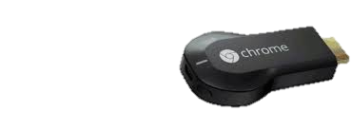
2. GOOGLE CHROMECAST

Slide 14
2. GOOGLE CHROMECAST
Android Tablet that needs to connect to a WIFI network
Chromecast stick that needs to connect to the same WIFI network
Forget about using the college WIFI for this. Instead create your own using either
a WIFI router
or if you have an unlimited data plan on your phone, simply turn on a WIFI hotspot on your phone
The Chromecast icon is displayed on your Android device. Turn it on to wirelessly mirror and transmit your screen to the Chromecast device which in turn is connected to the data projector. You’ll need a female HDMI-female VGA adapter for most old data projectors
NOTE: you can mirror the Chromecast browser from Windows and Mac computers & iOS using this method

Slide 15
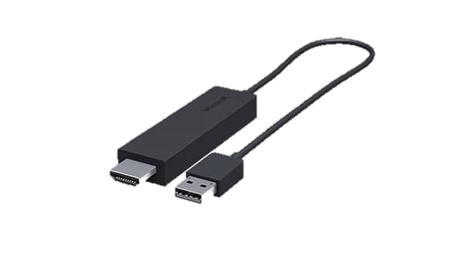
3. MICROSOFT

Slide 16
3. MICROSOFT
Microsoft Surface / Windows Tablet connects to a WIFI network
A Miracast compatible device connects to the same WIFI network
Forget about using the college WIFI for this. Instead create your own using either
a WIFI router
or if you have an unlimited data plan on your phone, simply turn on a WIFI hotspot on your phone
The Miracast icon is displayed on your Surface or table. Turn it on to wirelessly mirror and transmit your screen to the Miracast compatible device which in turn is connected to the data projector. You’ll need a female HDMI-female VGA adapter for most data projectors
Microsoft sells its own device called “Microsoft Wireless Display Adapter”

Slide 17
4. Amazon Fire TV:
Howto & Supported Devices
For AirPlay, picture is not rendered as well as AppleTV
Notes:
http://www.amazon.com/gp/help/customer/display.html?nodeId=201453020
http://wit-design-patterns-2016.github.io/part-1/topic01-context/index.html

Slide 18

5. Android TV Boxes
Some Android TV Boxes have WIFI & Ethernet and support all MIRACAST standards:
APPLE AIRPLAY
GOOGLE CHROMECAST
MICROSOFT MIRACAST
Notes:
Beware some cheaper ones have slower network speeds
Some sticks don’t allow you to have network option

Slide 19
RECORDING
SECTION 3

Slide 20
iPAD Pro
Powerful enough to make recordings at the same time (iPAD is not)
Within Final Argument you can drag a recording straight to YouTube
Example recordings
Notes:
http://www.amazon.com/gp/help/customer/display.html?nodeId=201453020
http://wit-design-patterns-2016.github.io/part-1/topic01-context/index.html

Slide 21
RECORDING - SWIVL
SWIVL
The camera follows you
Remote to zoom in/out
Save to cloud
$249
http://www.swivl.com/#top

Slide 22

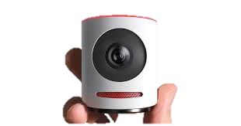
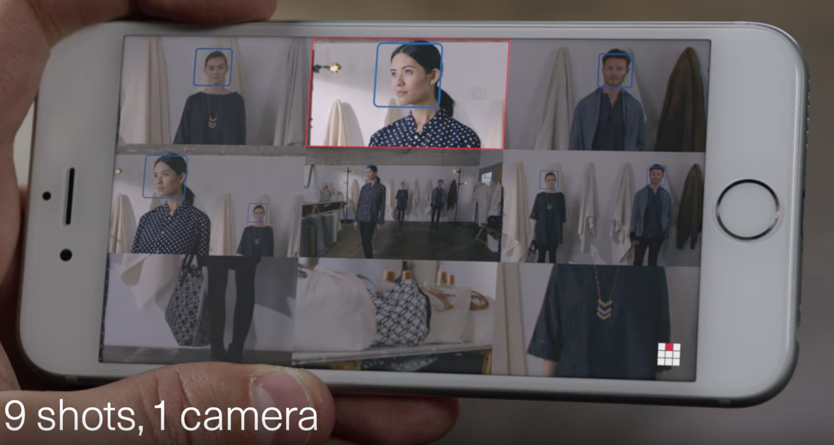
RECORDING - MOVI
MOVI – “The Live Event Camera”
1 button sharing
9 different shots from 1 camera
Tap to cut between shots
Pinch zoom
Drag to pan
Movement tracking
$299 - $549
https://getmovi.com/videos

Slide 23
Simple Recording Devices
Photo
Audio
Video
Notes
Photo
Audio
Video
Notes
Photo
Audio
Video
360 Photos
360 Video
VR
Do You have one of these devices?
Notes:
Ricoh Theata S

Slide 24
MEDIA HOSTING
SECTION 4

Slide 25
Making VIDEO Recordings Available – Media Hosting
Upload to YouTube
Private (only you)
Unlisted (anyone with URL)
Public (Listed in Google)
Upload to VIMEO
Upload to HEANET
media.heanet.ie
Using your WIT credentials

Slide 26
Making AUDIO Recordings Available – Media Hosting
Upload to HEANET
media.heanet.ie
Using your WIT credentials
Upload to SoundCloud
Upload to Podomatic

